Slide 1

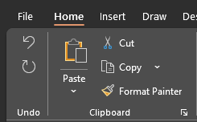
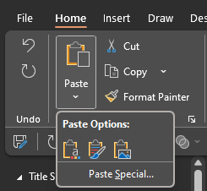
Copying and pasting slides into your own presentation
Copy any slide from this extended deck into your own presentation by selecting the slide in the thumbnail palette (to the left) before either clicking ‘Copy’ from the ‘Home’ menu.
Or Ctrl+C (PC) or Cmd+C (Mac).
You can then paste directly into your own presentation’s thumbnail palette using ‘Paste’ > ‘Keep source formatting’ on the ‘Home’ menu.
Or by right-click (PC) or alt+click (Mac) > ‘Keep source formatting’.
Automated Fulfillment Network in a Network Zone Consortia
Moshe Shechter, June 2024

Slide 2
The Automated Fulfillment Network

Slide 3




The Fulfillment Network
INFRASTRUCTURE ELEMENTS
Lender 1
Book
Borrower patron
Request/Loan
Borrower
Lender 2
Borrower patron -
Linked account
Lender 3

Slide 4
The Automated Fulfillment Network
INFRASTRUCTURE ELEMENTS
Lender 1
Book
Borrower patron
Request/Loan
Resource Sharing
Request:
Resource sharing library
Partner
Rota templates
Rota assignment rules
Borrower
Lender 2
Borrower patron -
Linked account
Lender 3

Slide 5
The Automated Fulfillment Network
The Automated Fulfillment Network (a.k.a.AFN) is an automation layer on top of the Fulfillment Network (FN)
It enables patrons to directly request from another institution in the network without having to search other institution’s discovery for a direct request
Benefits of an Automated Fulfillment Network:
Increased Efficiency: Automation speeds up the fulfillment process, reducing the time from order to delivery.
Cost Savings: Reduces labor costs and minimizes errors, leading to cost savings.
Enhanced Accuracy: Minimizes human errors, ensuring accurate and reliable order fulfillment.
Improved Satisfaction: Faster, more reliable service leads to higher customer satisfaction and loyalty.

Slide 6
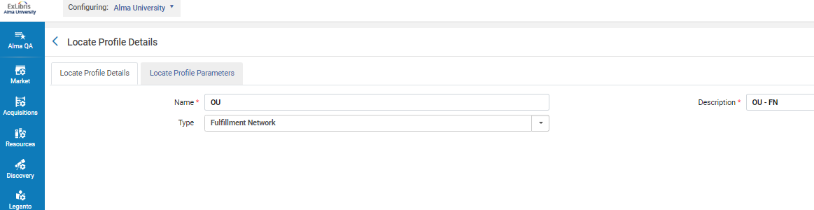
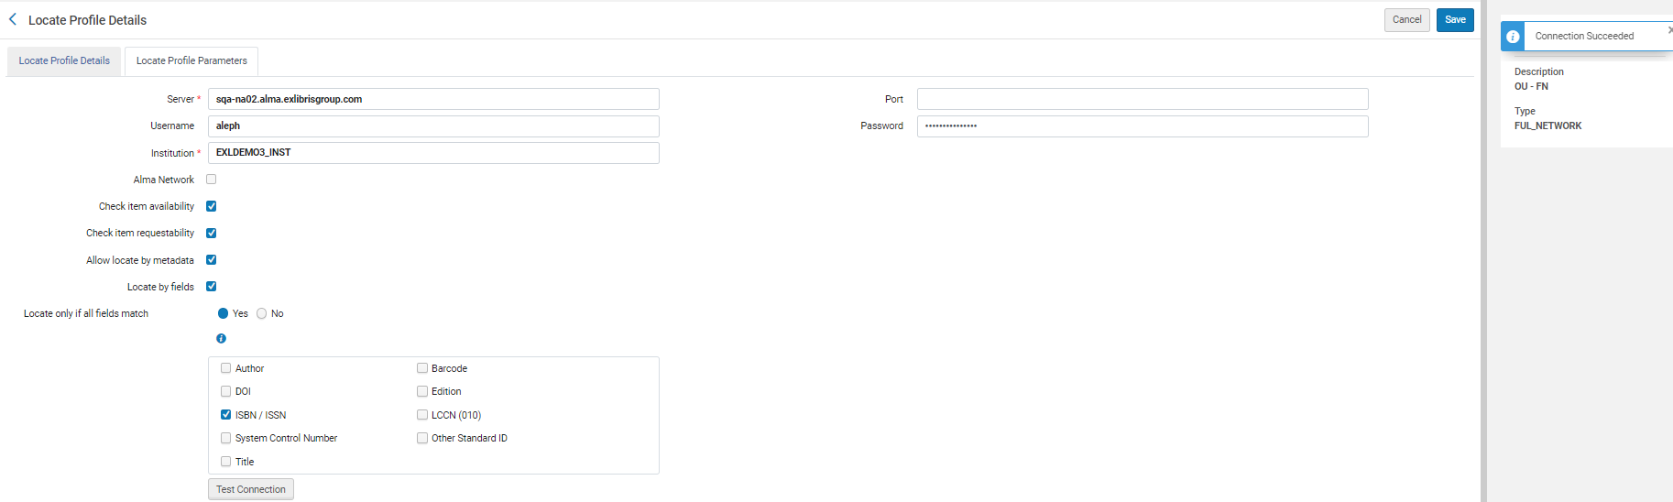
FN Locate Profile
Required to support requests placed not via a shared Primo

Slide 7
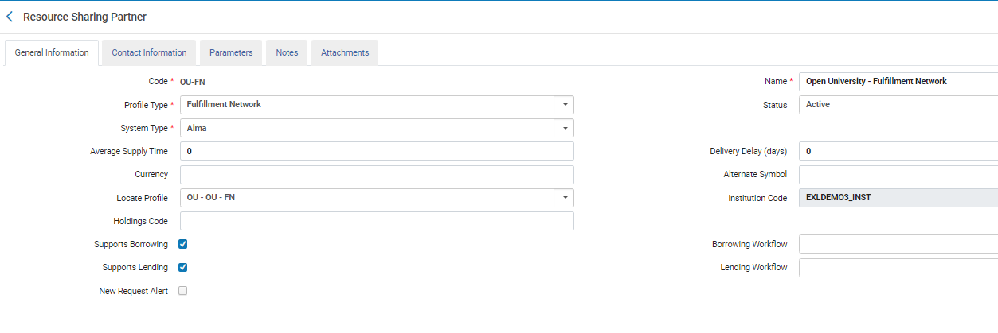
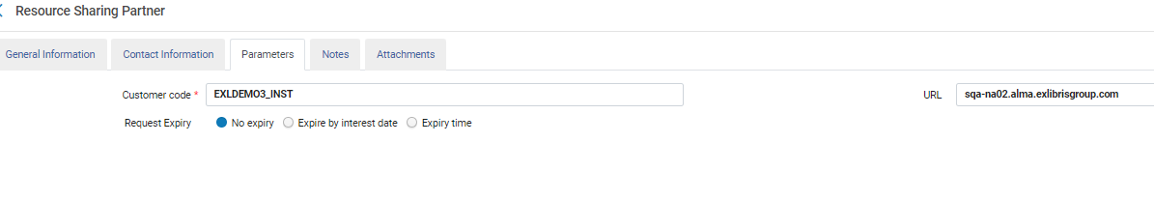
FN Partner

Slide 8
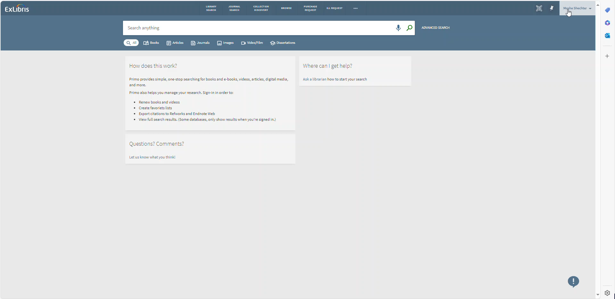
FN workflow

Slide 9
Setting up the Network
Setting up the Sharing of Users
Setting up the Fulfillment Attributes
Setting up an Automated Fulfillment Network (AFN)

Slide 10
Setting up the Network

Slide 11
Shared Password
For Alma institutions to communicate, they must share a password.
The password is set up using the Configuration menu > Resources > General > Other Settings option and setting up the networkSearchPassword parameter.
All participants of the network must have the same password.
This step is required only when no Network Zone (NZ) is in place. In situations where a shared NZ is used, the password is shared via the NZ setup

Slide 12
Setting up the Sharing of Users

Slide 13
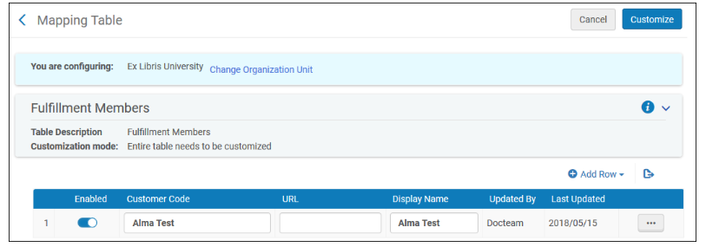
Setting up the Sharing of Users
Non Network Zone (NZ) Members
Setting up which institutions your institution shares fulfillment network services with is done by listing them using the Configuration menu > General > Network Groups > Fulfillment Member option.

Slide 14
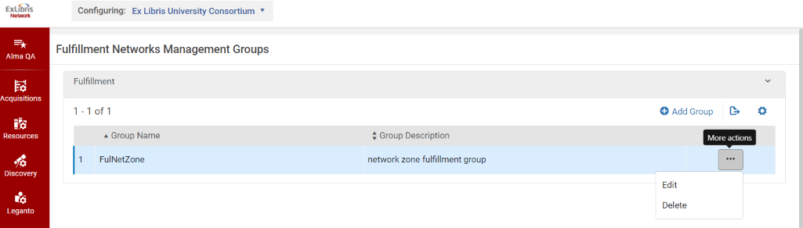
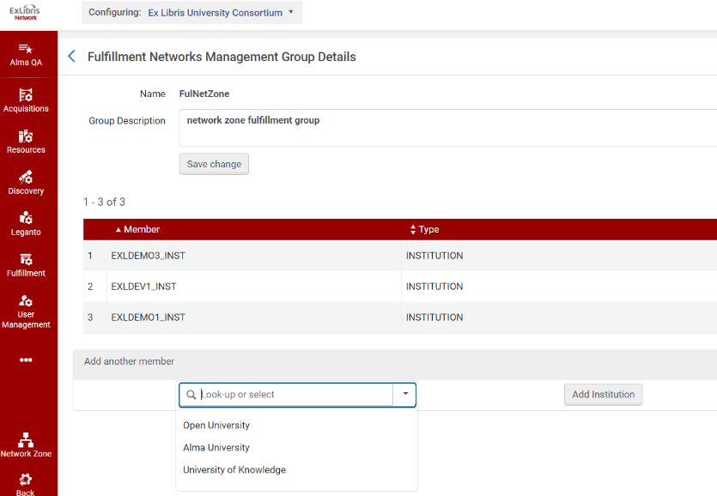
Setting up the Sharing of Users
Network Zone (NZ) Members
In an NZ, all members of the NZ are considered potential members of fulfillment networks within the NZ.
Configuring the members of the network is therefore done by setting up Fulfillment Groups in the Configuration menu > General > Network Groups > Fulfillment Member option at the NZ.
Using the mapping in this table, you define which institutions are part of a fulfillment network.
While this enables the flexibility of creating multiple fulfillment networks within the same NZ, the classic configuration is to list all the NZ members in one fulfillment group, creating a single network of all of the NZ members.

Slide 15
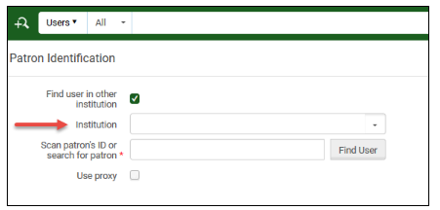
Testing Your Setup
Once the above elements have been configured, an option to Find users in other institutions is displayed when using the Manage Fulfillment Services (a.k.a. circulation desk) page and you see a list of the institutions you have configured.
The ability to actually pull a user record from another institution depends on the setup in the next section…

Slide 16
Setting up the Sharing of Users

Slide 17
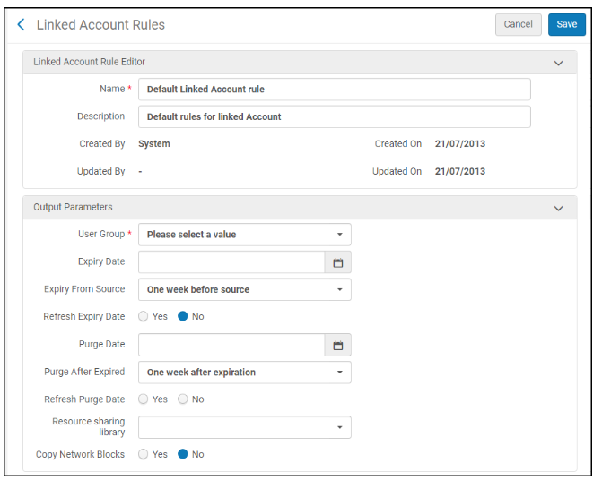
Linked Account Rules
Linked account rules determine how accounts are copied to your institution from another institution. This configuration option maps the values of the linked account that is created in your institution, for example:
The user group the account is set to
When the record expires
When the record is purged
If blocks at the source institution affect the linked account created in your institution
Linked account rules are configured using the Configuration menu > User Management > Collaborative Networks > Linked Account Rules option.

Slide 18
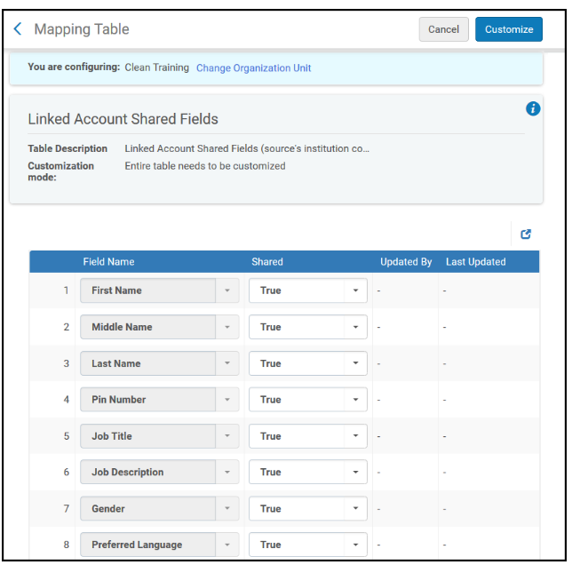
Linked Account Shared Fields
Linked Account Shared Fields setup enables you to control what fields from your patron records are copied over to another institution. It enables you to protect the privacy of your patrons, for example by setting this configuration to enable other institutions to pull only the patron name and email.
Linked account rules are configured using the Configuration menu > User Management > Collaborative Networks > Linked Account Shared Fields option.

Slide 19
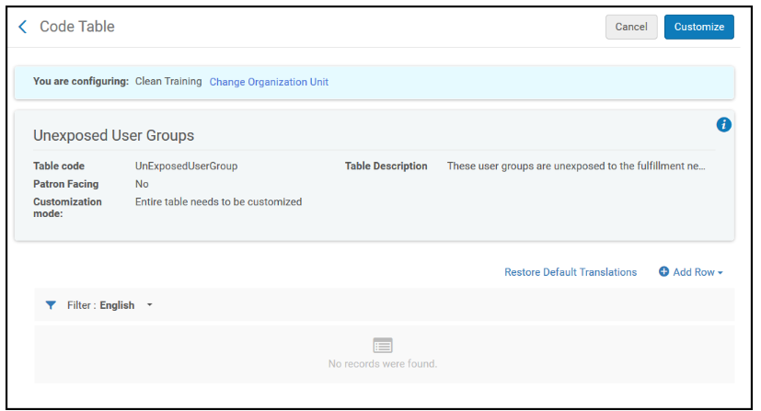
Restricted Users
Restricted Users setup enables you to determine which user groups are hidden from other institutions in a fulfillment network. Effectively, this excludes these user groups from being able to receive services at another institution, since their user record is not shared with another institution.
This can be configured for several reasons, such as:
Some user groups may not be eligible for fulfillment network services because of institutional fulfillment policies
Some users' records may be considered private and not allowed for sharing because of privacy concerns
Restricted Users rules are configured using the Configuration menu > User Management > Collaborative Networks > Restricted Users option.

Slide 20
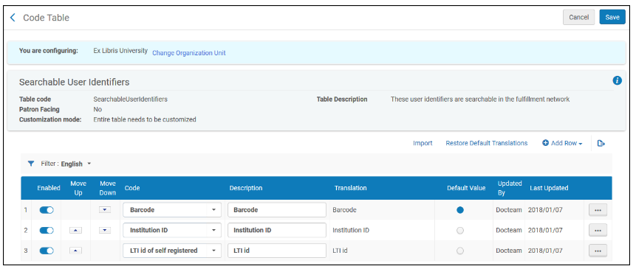
Searchable Identifiers
Searchable Identifiers define which user identifiers are searchable via the fulfillment network process for fetching patron information.
A typical use case is where not all patrons are eligible for fulfillment network services.
Only patrons that are granted the ID types configured in this table are able to get fulfillment network service
Only by using the IDs of the types configured here when identifying at the circulation desk of a remote library.
Searchable Identifiers are configured using the Configuration menu > User Management > Collaborative Networks > Searchable Identifiers option.

Slide 21
Cross Consortia Identifiers
if you want user IDs of linked account to be copied from the source institution to the linked account you can use the Configuration menu > User Management > General > Collaborative Networks>Cross Consortia Identifiers option to determine the identifiers of which type will be copied over. At minimum, using this option will cause the Primary ID to be copied from the source institution to the linked account.
For members of a NZ, this option may be configured in the NZ.

Slide 22
Consortially Unique Identifiers
If the user IDs in the network are fully unique, such as, the same ID is not used for identifying two different patrons in two different institutions, then you may set up the network_users_unique_identifiers parameter to FULL.
This way, when patrons approach a desk in your library, there is not a need to first select their source institution before scanning in their ID. By only scanning in their ID, Alma finds the correct record in whatever institution in the network and pulls the user record.
This option is configured using the Configuration menu > User Management > General > Other Settings option, and setting the network_users_unique_identifiers parameter to FULL. These rules affect how accounts are pulled to your institution from other institutions.
This option should only be used if you can guarantee that user IDs are 100% unique across the network.
If user IDs are not 100% unique across the network, then consult the Ex Libris staff. In cases where there is a high level of uniqueness, a setup may still be done such that unique records are automatically identified without requiring to select the source institution, and where a non-unique ID is scanned in a select option, a pop up is displayed enabling to select the correct record.

Slide 23
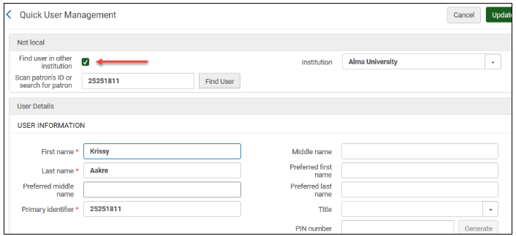
Testing Your Setup
Identify a user record in institution A in which you want to receive fulfillment services at institution B.
In institution B, access the Manage Patron Services page.
Select Find user in other institution. From the drop-down, select Institution A.
Scan the ID of the record you identified in step 1.
The setup needs to be done at two institutions before a test is completed;
The institution from which the user record is pulled
The institution to which it will be placed

Slide 24
Setting up the Fulfillment Attributes

Slide 25
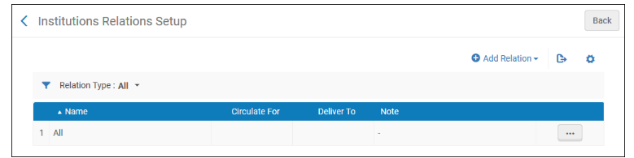
Institution Relations
Institution relations determine:
Which institution can potentially deliver items to which other institution
Which institution can potentially circulate (check in\out) items of another institution
This is configured using the Configuration menu > General > Network Groups > Institution Relations option at the NZ or at the IZ.
Select Add Relation to add a new relation. The Add Relation pane appears. Populate the pane as follows:
From - select the institution whose fulfillment network behavior is configured. This field is only configured for a Network Zone institution.
To - configure the institution who participates as a remote institution in the fulfillment process.
Select Deliver To and/or Circulate For.
Optionally add a note in Note.

Slide 26
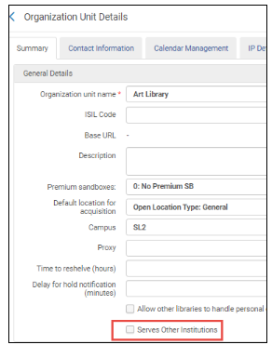
Setting up Libraries
Libraries can check out\in items from libraries of other institutions only if they are set as libraries that serve other institutions.
When configuring a library (Configuration menu > General > Libraries > Add a Library or Edit Library Information), select the Serves Other Institutions check box for libraries that are able to process items from other institutions at their primary desks.

Slide 27
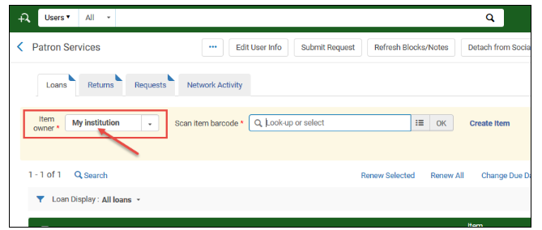
Testing Your Setup
It is now possible to use the Manage Patron Services page to scan in item barcodes from institutions that your institution has 'circulate for' relations with (see above).
This is possible only at primary desks of libraries that have been set to service other institutions

Slide 28
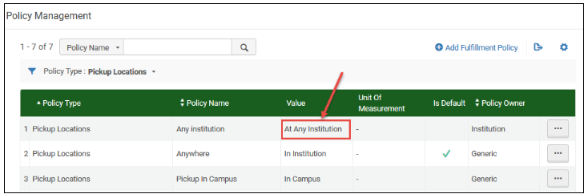
Pickup Anywhere
To be able to request an item for pickup at another institution, the item’s request policy must have the Pickup Location Policy set to At Any Institution.
Verify that you have defined such a pickup policy.
Confirm using it at a Time-of-Use (TOU) that you want to apply to items that are requestable for pickup at other institutions.

Slide 29
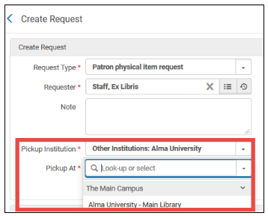
Testing Your Setup
It is now possible to use the Alma request form to request an item for pickup at another institution.
Find an item that a known patron is able to request for pickup at any institution as per your rules (use the Fulfillment Configuration Utility to verify the item is indeed requestable for this patron for pickup anywhere), and open its request form.
The request form enables requesting for pickup at institutions that your institution is set up to have Deliver To relations with (see above).
Only libraries that serve other institutions (see above) are displayed.

Slide 30
Summary - The Layers of AFN
Resource Sharing
Fulfillment Network
Sharing Users
Network

Slide 31
Thank you
Moshe Shechter
Moshe.shechter@clarivate.com

